Slide 1

Technology in Action
15th Edition
Chapter 7
Networking: Connecting Computing Devices
Notes:
If this PowerPoint presentation contains mathematical equations, you may need to check that your computer has the following installed:
1) MathType Plugin
2) Math Player (free versions available)
3) NVDA Reader (free versions available)

Slide 2
Learning Objectives (1 of 2)
7.1 Describe computer networks and their pros and cons.
7.2 Explain the different ways networks are defined.
7.3 Describe the types of transmission media used in networks.
7.4 Describe the basic hardware devices necessary for networks.
7.5 Describe the type of software necessary for networks.
7.6 Summarize the broadband options available to access the Internet.
Notes:
Slide 2 is a partial list of textbook Learning Objectives numbers and statements.

Slide 3
Learning Objectives (2 of 2)
7.7 Summarize how to access the Internet wirelessly.
7.8 Explain what should be considered before creating a home network.
7.9 Describe how to set up a home network.
7.10 Summarize how to configure home network software.
7.11 Describe the potential problems with wireless networks and means to avoid them.
7.12 Describe how to secure wireless home networks.
Notes:
Slide 3 is the final list of textbook Learning Objectives numbers and statements.

Slide 4
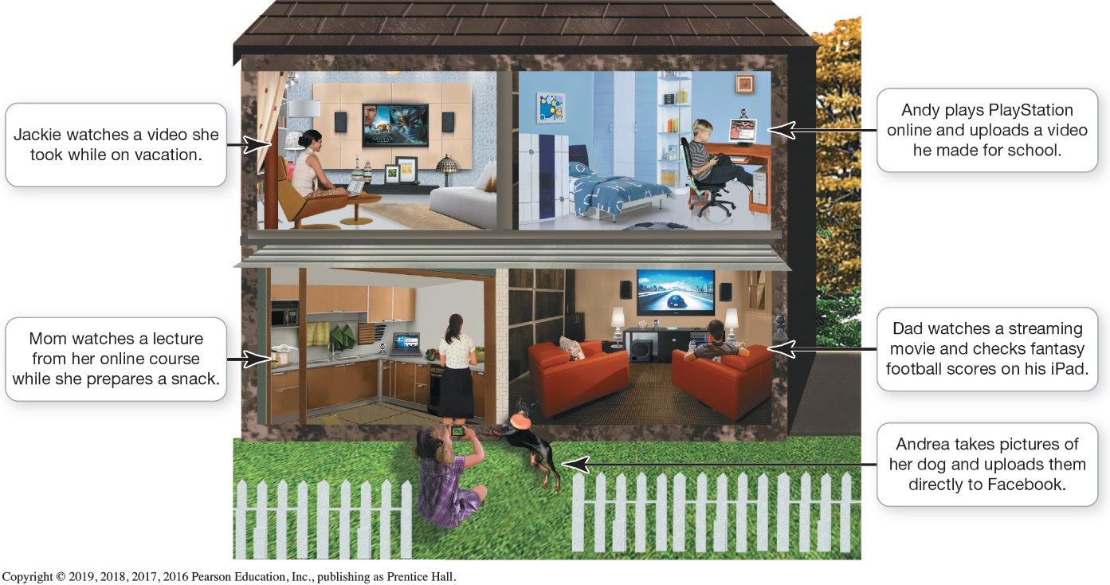
Networking Fundamentals Understanding Networks (1 of 3) (Objective 7.1)
Computer network
Node
Computer
Peripheral
Network device
Notes:
A computer network is simply two or more computers that are connected via software and hardware so that they can communicate with each other.
Each device connected to a network is referred to as a node.
A node can be a computer, a peripheral such as a printer or game console, or a network device such as a router.

Slide 5
Networking Fundamentals Understanding Networks (2 of 3) (Objective 7.1)
Benefits of networks
Sharing a high-speed Internet connection
Sharing printers and peripheral devices
Sharing files
Common communications
Disadvantage of networks
Setup and administration
Notes:
There are several benefits to having computers networked:
Sharing an Internet connection: A network lets you share the high-speed Internet connection coming into your home.
Sharing printers and other peripherals: Networks let you share printers and other peripheral devices.
Sharing files: You can share files between networked computers without having to use portable storage devices to transfer the files.
Common communications: Computers running different operating systems can communicate on the same network.
The major disadvantage of networks is the setup time.

Slide 6
Networking Fundamentals Understanding Networks (3 of 3) (Objective 7.1)
How data moves through networks
Data transfer rate (bandwidth) is the maximum speed data can be transmitted
Throughput is the actual speed data is transferred
Measured in megabits per second (Mbps) or gigabits (Gbps)
Notes:
The following terms help us understand how data moves through networks.
Data transfer rate (bandwidth) is the maximum speed data can be transmitted.
Throughput is the actual speed data is transferred.
Data transfer rate and throughput are usually measured in megabits per second (Mbps) and gigabits per second (Gbps).

Slide 7
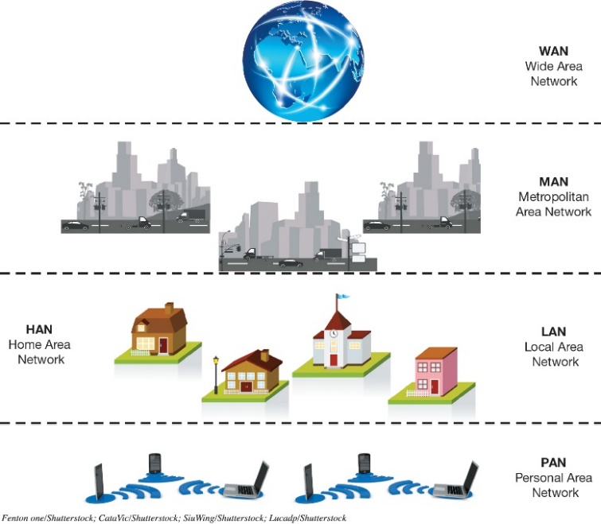
Network Architectures Network Designs (1 of 3) (Objective 7.2)
Networks can be classified by distance
Personal area network (PAN)
Local area network (LAN)
Home area network (HAN)
Metropolitan area network (MAN)
Wide area network (WAN)
Notes:
Networks can be classified by distance.
A personal area network (PAN) is used for communication among devices close to one person.
A local area network (LAN) is a network in which the nodes are located within a small geographical area.
A home area network (HAN) is a specific type of LAN located in a home.
A metropolitan area network (MAN) is a large network designed to provide access to a specific geographical area, such as an entire city.
A wide area network (WAN) spans a large physical distance.

Slide 8
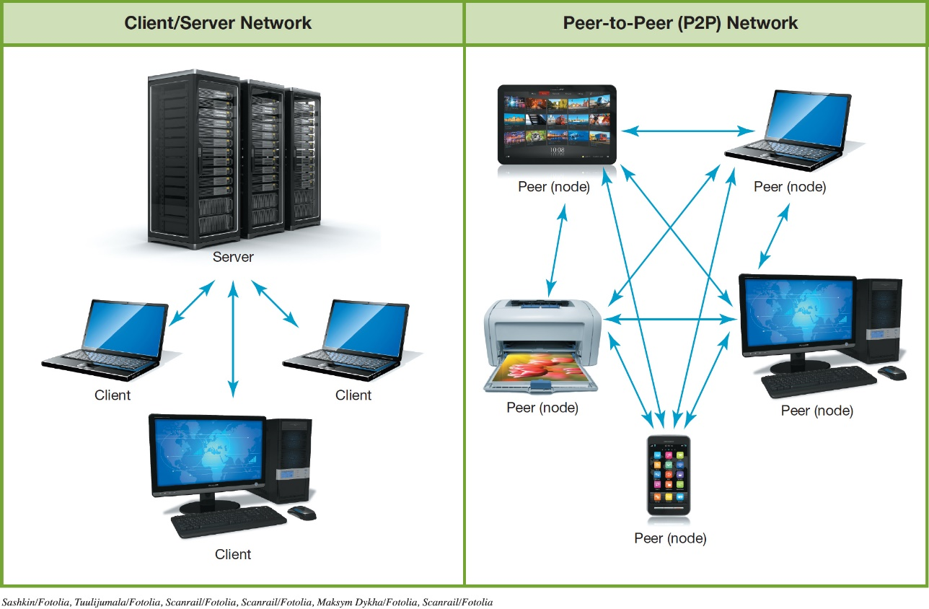
Network Architectures Network Designs (2 of 3) (Objective 7.2)
Networks can be classified by levels of administration
Client/server network
Peer-to-peer (P2P) network
Notes:
Networks can be classified by levels of administration.
In a client/server network, a client is a computer on which users accomplish tasks and make requests, whereas the server is the computer that provides information or resources to the client computers.
In a P2P network, each node connected on the network can communicate directly with every other node on the network.

Slide 9
Network Architectures Network Designs (3 of 3) (Objective 7.2)
Networks can be classified by the protocols used
Ethernet
Developed by the Institute of Electrical and Electronics Engineers (IEEE)
Wireless networks (Wi-Fi)
Wired networks (gigabit Ethernet (GbE))
Backwards compatibility
Notes:
Networks can be classified by the protocols used.
Ethernet
Developed by the Institute of Electrical and Electronics Engineers (IEEE).
This applies to wireless and wired networks.
The ability of current devices to use earlier standards in addition to the current standard is known as backward compatibility.

Slide 10
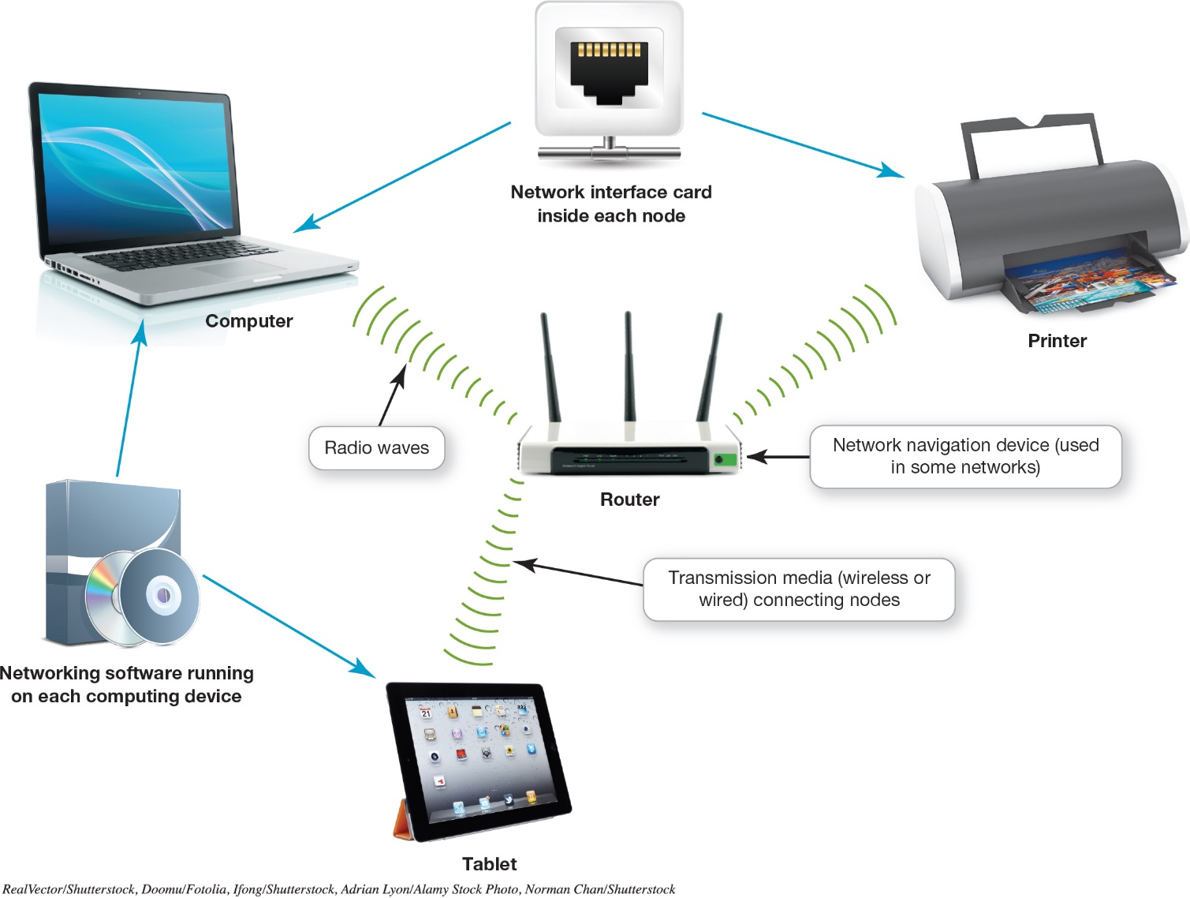
Network Components (Objective 7.3)
Notes:
In order to function, all networks must include:
A means of connecting the nodes on the network—cables or wireless technology.
Special hardware devices that allow the nodes to communicate with each other and to send data.
Software that allows the network to run.

Slide 11
Network Components Transmission Media (1 of 2) (Objective 7.3)
Transmission media establish a communications channel between the nodes on a network.
Wireless networks
Wired networks
Notes:
Transmission media establish a communications channel between the nodes on a network. They can be either wireless or wired.

Slide 12
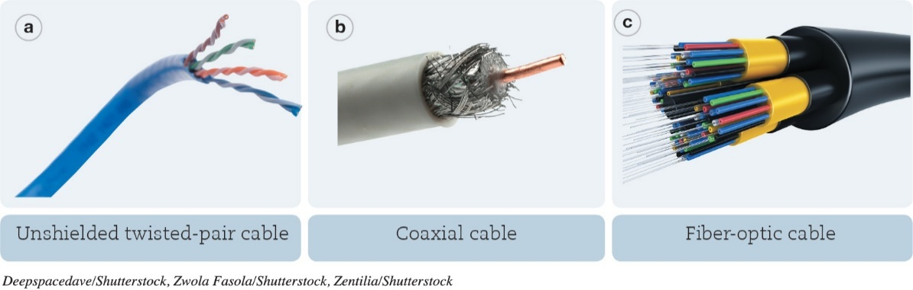
Network Components Transmission Media (2 of 2) (Objective 7.3)
Wired
UTP cable – twisted copper wires surrounded by a plastic jacket
Coaxial cable – single copper wire surrounded by layers of plastic
Fiber-optic cable – plastic or glass fibers
Notes:
Wired networks can use the following media:
UTP cable – twisted copper wires surrounded by a plastic jacket.
Coaxial cable – single copper wire surrounded by layers of plastic.
Fiber-optic cable – plastic or glass fibers.

Slide 13
Network Components Basic Network Hardware (Objective 7.4)
Network adapter
Network interface card (NIC)
Modem
Router
Switch
Internet of Things (IoT)
Notes:
Each node needs a network adapter. An integrated network adapter is referred to as a network interface card.
A broadband connection requires a modem, which translates the signal into digital and back again.
Data is sent in bundles called packets.
Network navigation devices facilitate and control the flow of data.
A router transfers packets of data between two or more networks.
A switch acts like a traffic signal on a network.
The IoT is defined as the interconnection of uniquely identifiable embedded computing devices that transfer data over a network without requiring human-to-human or human-to-computer interaction.

Slide 14
Network Components Network Software (Objective 7.5)
Operating system for P2P networking
Client/server network
Communicate through centralized server
Specialized network operating system (NOS) software
Notes:
Because home networks are P2P networks, they need operating system software that supports P2P networking.
As opposed to P2P networks, the nodes on a client/sever network don’t communicate directly with each other; rather, they communicate through a centralized server. Communicating through a server is more efficient in a network with a large number of nodes, but it requires more complex software. Therefore, servers on client/server networks have specialized network operating system (NOS) software installed.

Slide 15
Connecting to the Internet Broadband Internet Connections (1 of 2) (Objective 7.6)
Home network
Share an Internet connection
Must purchase Internet access from ISP
Specialized providers
Companies that provide other services
Broadband
Cellular or Dial-up
Notes:
One of the main reasons for setting up a network is to share an Internet connection. Some businesses and large organizations have a dedicated connection to the Internet, but other businesses and homeowners purchase Internet access from Internet service providers (ISPs). ISPs might be specialized providers.
Broadband is the preferred way to access the Internet, but in some situations cellular or dial-up access might be necessary.

Slide 16
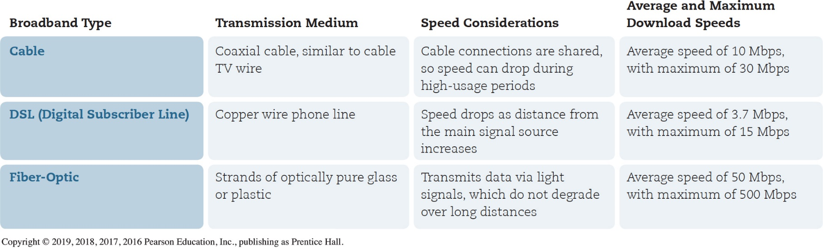
Connecting to the Internet Broadband Internet Connections (2 of 2) (Objective 7.6)
Broadband
Cable Internet
DSL (digital subscriber line)
Fiber-optic service
Satellite Internet
Notes:
Broadband is often referred to as high-speed Internet. This high rate of access is in contrast to dial-up Internet access.
The standard wired broadband technologies in most areas are cable, DSL, and fiber optic service.
Satellite Internet is used mostly in rural or mountain areas.

Slide 17
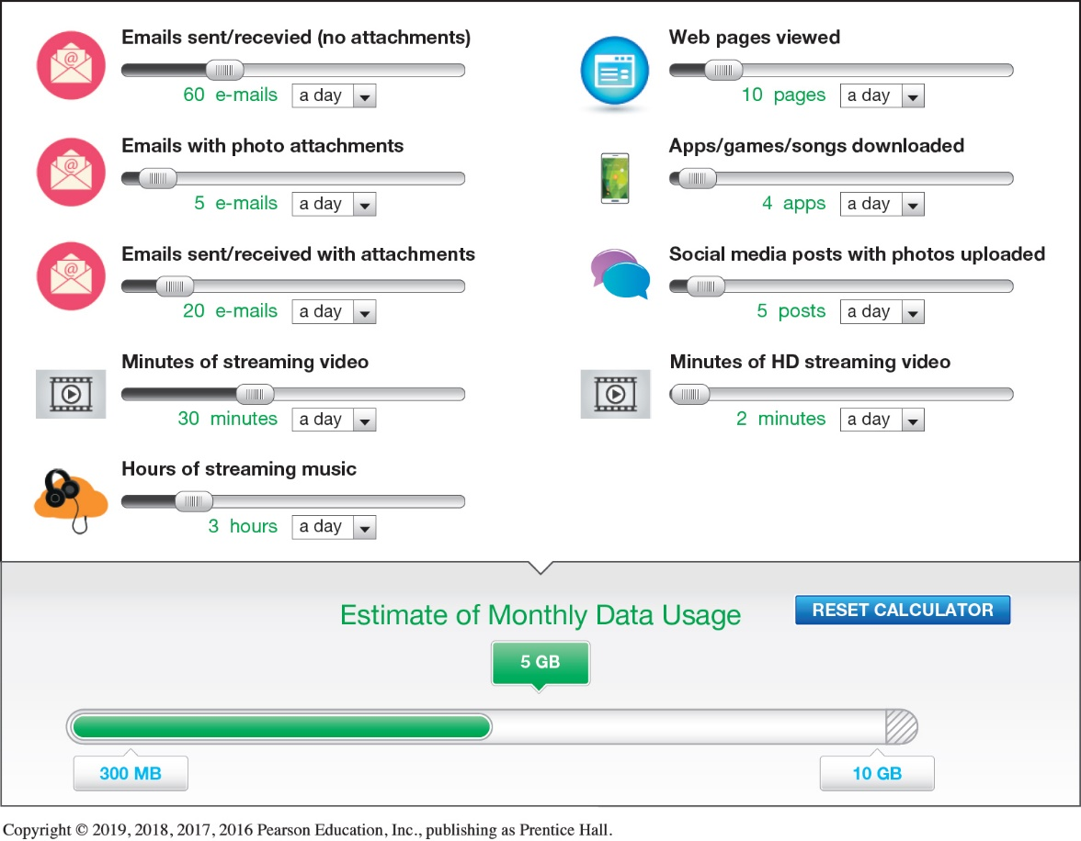
Connecting to the Internet Wireless Internet Access (Objective 7.7)
Mobile broadband
Wireless Internet at home
Mobil hotspot
Wireless ISP
Data plan
Notes:
To access the Internet wirelessly at home, you need to establish WiFi on your home network by using a router.
When away from home, you can find a Mobil hotspot.
Mobile broadband connects you to the Internet through 3G or 4G access.
You must have a wireless Internet service provider.
An Internet connectivity plan is known as a data plan.

Slide 18
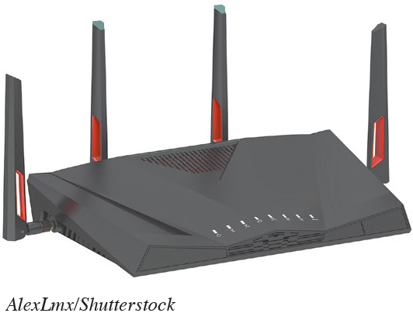
Installing and Configuring Home Networks Planning Your Home Network (Objective 7.8)
List all the devices you are using
Use the latest standards
Use the newest equipment
Notes:
One of the first things you should do to evaluate your network is list all the devices you’re using.
For a home network to run most efficiently and to provide the fastest experience, it’s best that all network nodes use the latest Ethernet standard.
If your router is provided by your ISP and it’s an older standard, you should consider having your ISP provide you with a new router.

Slide 19
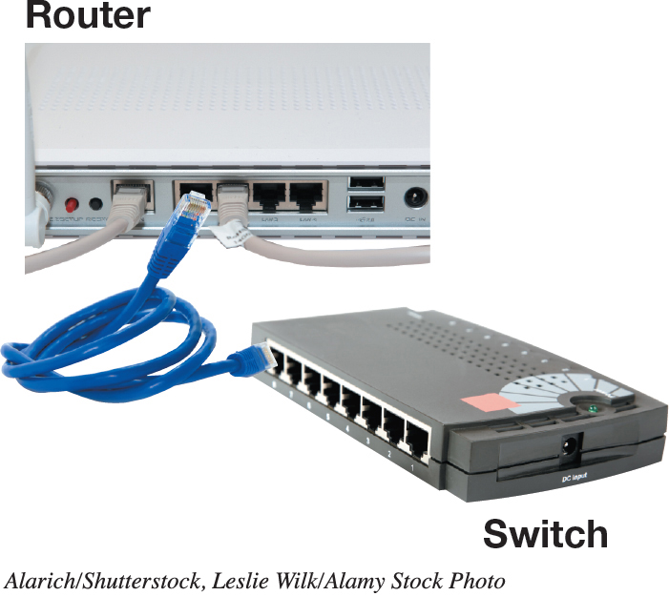
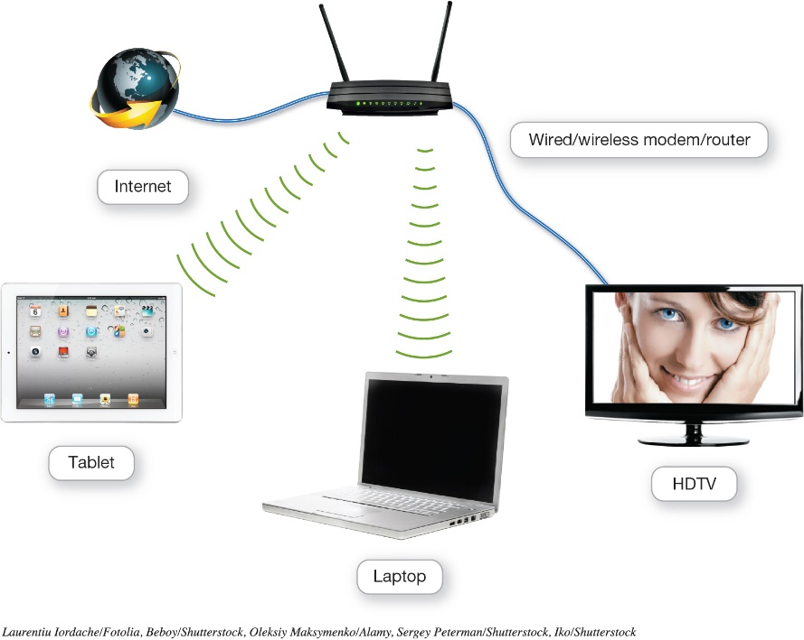
Installing and Configuring Home Networks Connecting Devices to a Network (1 of 2) (Objective 7.9)
Routers
Switches
Notes:
All routers that support the 802.11n standard (and newer 802.11ac) should work with computers running Windows or OS X. However, Apple has designed routers that are optimized for working with Apple computers.
Windows machines can also connect to an AirPort router, so it’s a great choice for households with both Apples and PCs.
The AirPort Express router can be used for home networks to support devices running iOS, macOS, and Windows.
A switch acts like a traffic signal on a network.

Slide 20
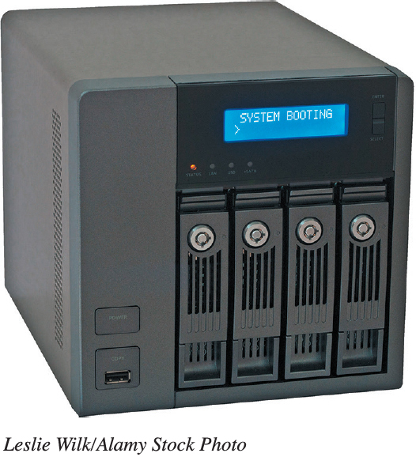
Installing and Configuring Home Networks Connecting Devices to a Network (2 of 2) (Objective 7.9)
Specialized Home Networking Devices
NAS devices
Home network servers
Network-ready device
Notes:
There are specialized home networking devices.
Network-attached storage (NAS) devices are specialized devices designed to store and manage network data. NAS devices provide centralized data storage and access.
Home network servers are specialized devices designed to store and share files across the network.
A network-ready device (or Internet-ready device) can be connected directly to a network through either a wired or wireless connection.

Slide 21
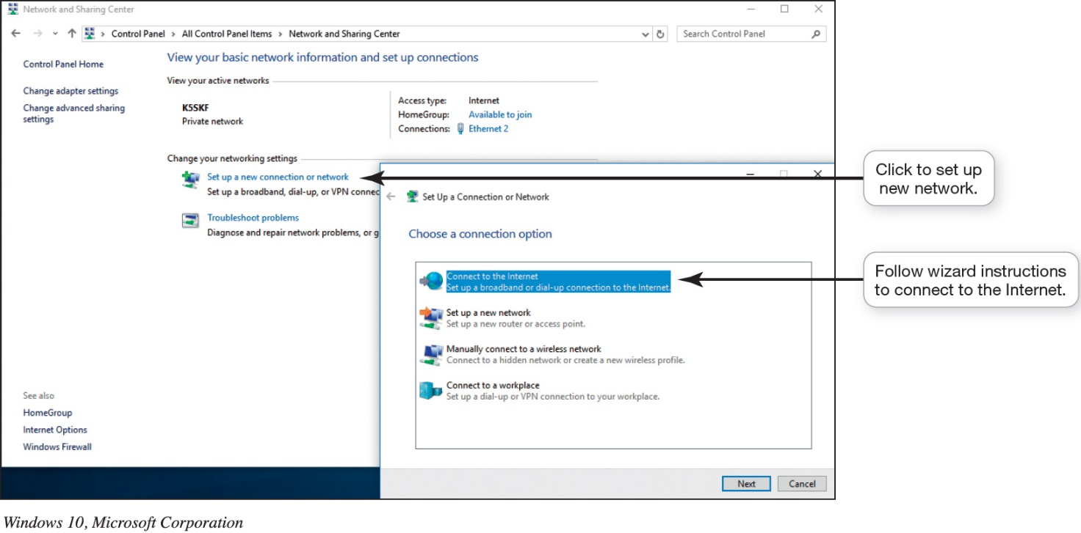
Installing and Configuring Home Networks Configuring Software for Your Home Network (Objective 7.10)
Setting up a Windows based network
Sharing files
Connecting mobile devices
Notes:
In Windows, the process of setting up a network is fairly automated, especially if you’re using the same version of Windows on all your computers.
For ease of file and peripheral sharing, Windows has the HomeGroup feature.
Connecting a mobile device to a wireless network is an easy process, regardless of its operating system.

Slide 22
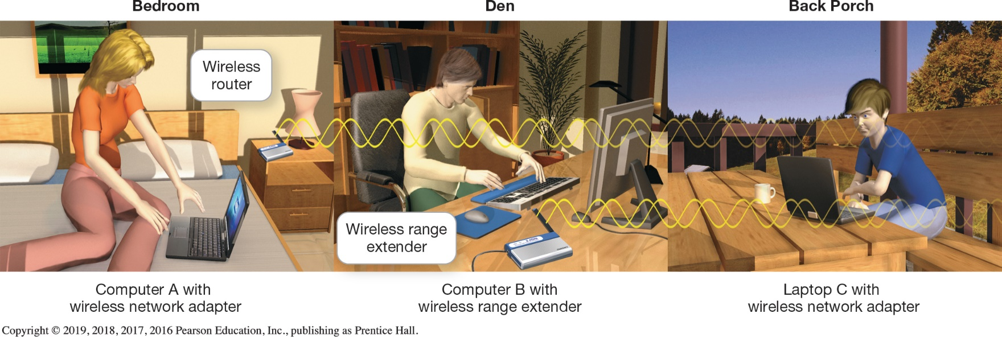
Managing and Securing Wireless Networks Troubleshooting Wireless Network Problems (Objective 7.11)
Range
Speed (throughput)
Range extender
Notes:
The maximum range of 802.11n or 802.11ac wireless devices is about 350 feet. But as you go farther away from your router, the speed (throughput) you achieve decreases.
Repositioning the node within the same room—sometimes even just a few inches from the original position—can affect communication between nodes.
A wireless range extender is a device that amplifies your wireless signal to extend to parts of your home that are experiencing poor connectivity.

Slide 23
Managing and Securing Wireless Networks Securing Wireless Networks (1 of 3) (Objective 7.12)
Use encryption and security protocols
Change network name (SSID)
Disable SSID broadcast
Change the default password
Create a passphrase
Implement media access controls
Notes:
There are various issues and methods for securing your wireless network.
Use encryption and security protocols
Change network name (SSID)
Disable SSID broadcast
Change the default password
Create a passphrase
Implement media access controls

Slide 24
Managing and Securing Wireless Networks Securing Wireless Networks (2 of 3) (Objective 7.12)
Limit signal range
Apply firmware upgrades
Disable remote access
Keep router firmware up to date
Notes:
Additional methods for securing your wireless network include:
Limit signal range
Apply firmware upgrades
Disable remote access
Keep router firmware up to date

Slide 25
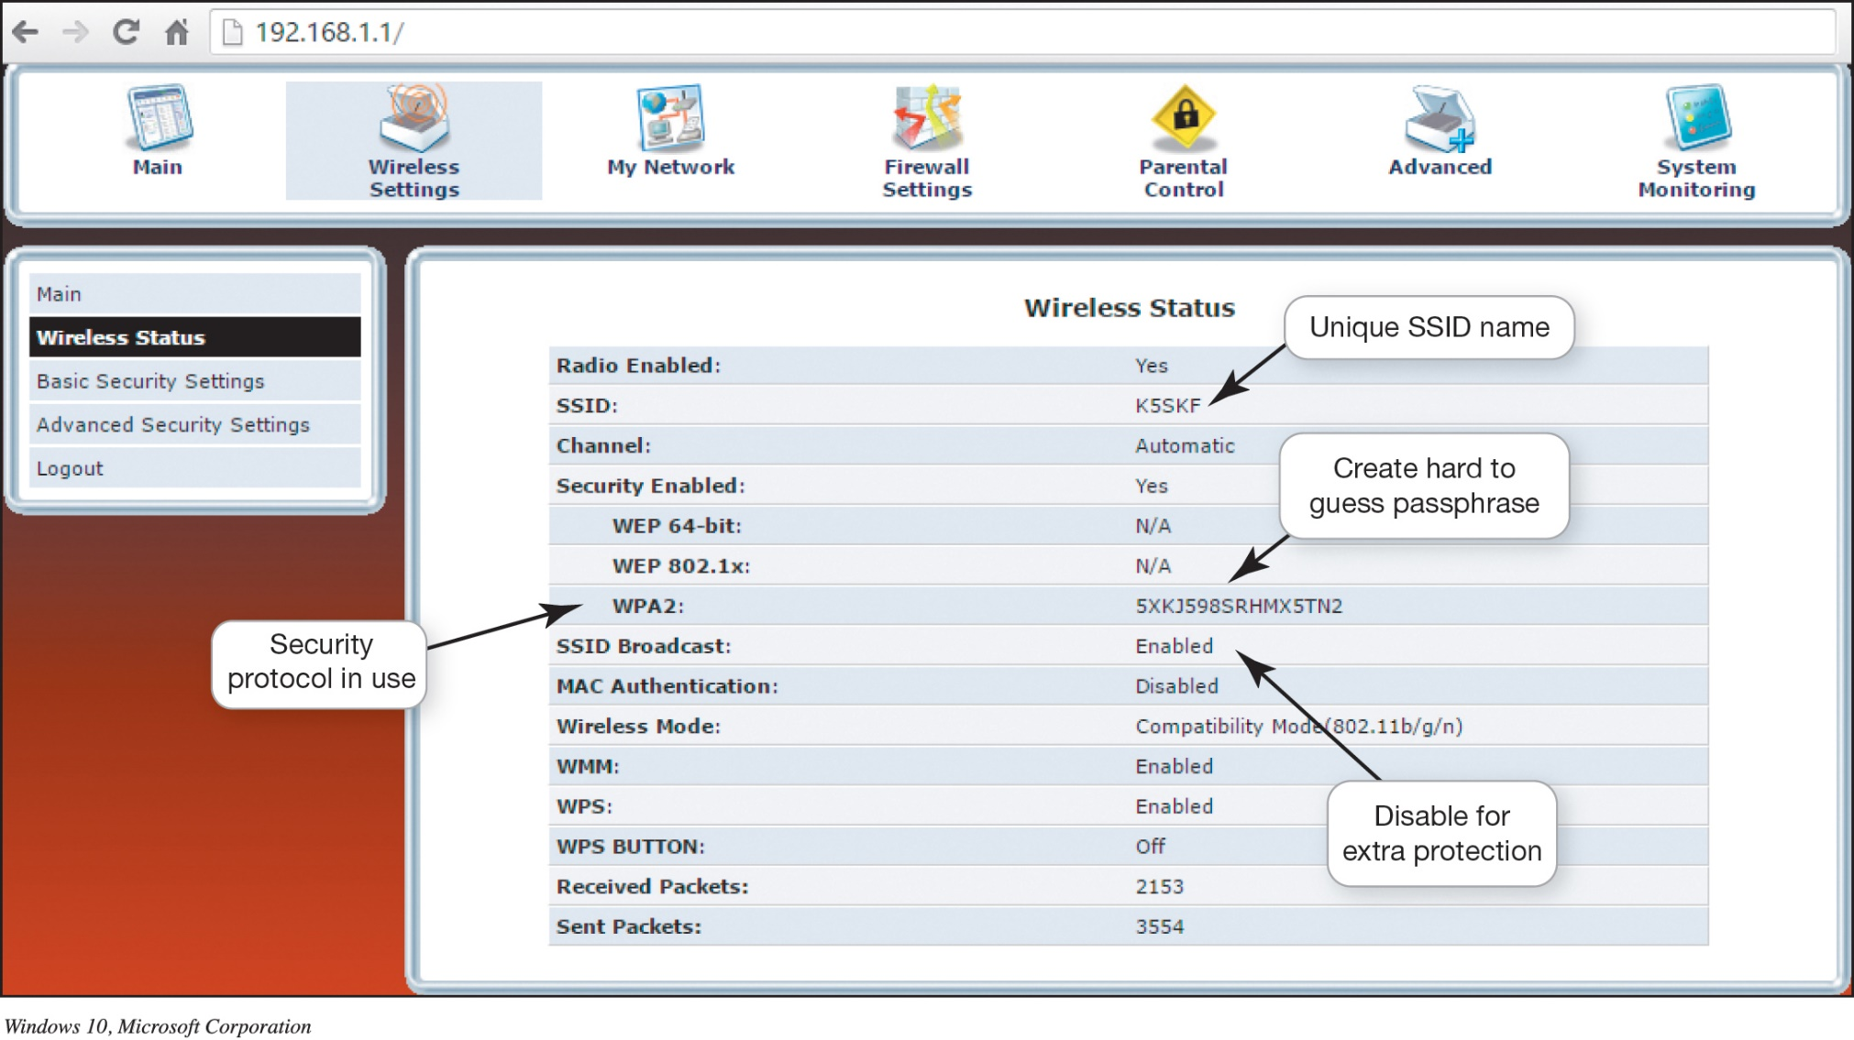
Managing and Securing Wireless Networks Securing Wireless Networks (3 of 3) (Objective 7.12)
Notes:
By accessing your router, you can configure the security protocols available on your router and change the SSID.

Slide 26
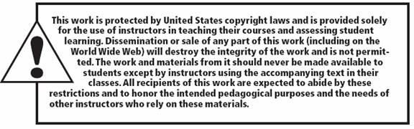
Copyright
All rights reserved. No part of this publication may be reproduced, stored in a retrieval system, or transmitted, in any form or by any means, electronic, mechanical, photocopying, recording, or otherwise, without the prior written permission of the publisher. Printed in the United States of America.

